Slide 1
HUMAN RESOURCE PLANNING
MODULE 2

Slide 2
HUMAN RESOURCE PLANNIG (HRP)
MEANING:
HRP is the process of getting the right number of qualified people into the right job at the right time so that an organisation can meet its objectives.
DEFINITION
“Manpower planning is the process by which a firm ensures that it has the right number of people and the right kind of people, at the right places, at the right time, doing things for which they are economically mast useful”. – Edwin B. Geisler
The process of determining manpower requirements and the means for meeting those requirements to carry out the integrated plan of the organization.” – Bruce P. Coleman

Slide 3
FEATURES OF HRP
It is future oriented
It is a continuous process
Integral part of Corporate Planning
Optimum utilization of resources
Both Qualitative and Quantitative aspect
Long term and Short term
Involves study of manpower requirement
OBJECTIVES OF HRP
Achieve Goal
Estimates future organizational structure and Manpower requirements
Human resource audit
Job analysis

Slide 4
PURPOSE OF HRP
To analyze and evaluate the available human resources within the organization & how to obtain the kinds of needed personnel.
It aims at minimization of waste in employing people ,lessen uncertainty of current personnel levels and future needs & to eliminate mistakes in staffing pattern
Aims at maintaining required level of skills
Helps in stopping the profit eroding effects of being overstaffed or understaffed
Shaping the optimum future workforce composition by hiring right skill in appropriate numbers.
NEED FOR HRP
Shortage of skills
Frequent labor turnover
Changing need of technology
Identify areas of surplus or shortage of personnel
Changes in organization design and structure.

Slide 5
PROBLEMS WITH HRP
Resistance by employers and employees
Inadequacies in quality of information.
Uncertainties
Time and expense
GUIDELINES FOR MAKING HRP EFFECTIVE
Adequate information system
Participation
Adequate organization
HRP should be balanced with corporate planning
Appropriate time horizon.

Slide 6
Factors affecting HRP
Internal factors
Company strategies
HR policies
Job analysis
Time horizon
Type and quality of information
Company’s production and operational policy
Trade unions
Organizational growth cycle
External factors
Government policies
Level of economic development
Information technology
Level of technology
Business environment
International factors

Slide 7
HRP PROCESS
Analyzing organizational objectives
Inventory of present human resources
Forecasting demand and supply of human resources
Estimating manpower gaps
Formulating the final human resource action plan
Monitoring, control and feedback

Slide 8
Recruitment
The recruitment process involves finding the candidate with the best skills, experience, and personality to fit the job. It requires a series of collecting and reviewing resumes, conducting job interviews, and finally selecting and onboarding an employee to start working for the organization.
According to Edwin B. Flippo, “It is a process of searching for prospective employees and stimulating and encouraging them to apply for jobs in an organisation.” He further elaborates it, terming it both negative and positive.

Slide 9
Objectives
Business growth
Filling vacancies
Changing job roles
Intrenal promotion
Increasing workload.
Factors Influencing Recruitment
External factors
Supply and demand
Unemployement rate
Labour market
Political –social legal environment
Competitors
Internal factors
Human resource planning
Recruitment planning
Size of firm
cost

Slide 10
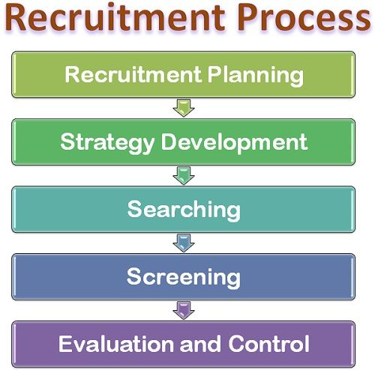

Slide 11
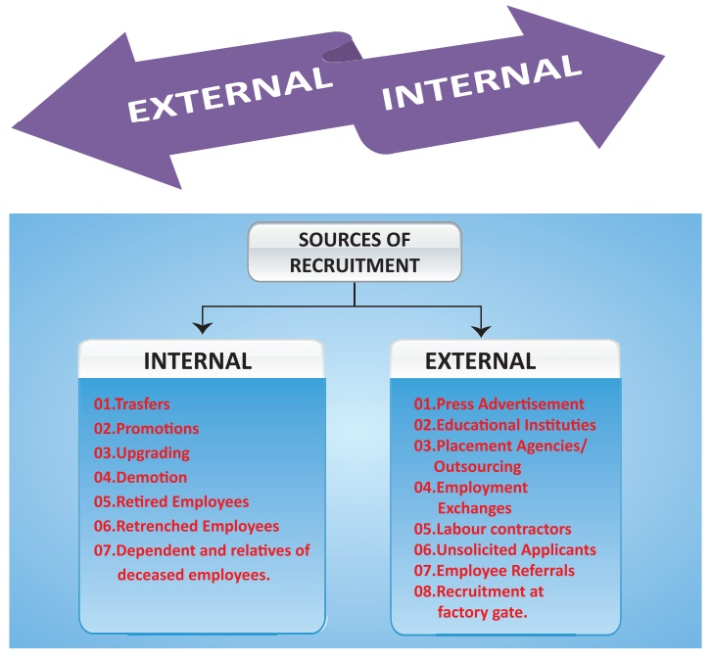

Slide 12
SELECTION
According to Harold Koontz, “Selection is the process of choosing from the candidates, from within the organization or from outside, the most suitable person for the current position or for the future positions.”
According to Dale Yoder, “Selection is the process by which candidates for employment are divided into classes those who will be offered employment and those who will not.”
Objectives
Selects suitable candidates
Verifies applicant’s capabilities
Places right candidate at right job
Generates Information about candidate
Save costs.
Preliminary Interview -
simple questions will be asking
enable the organisation to reject applicants who are unsuitable for jobs
Interviewer should be –who encourage confidence, genuinely interested in people, trustworthy. Apart from these qualities, he should be polite, friendly, open-minded

Slide 13
Application forms
Used to gain basic details about the candidates and data for future use
Identify the interested areas of candidates
Helps to pass information to management and interview board.
Purpose of application
provide concise, factual information
To facilitate effective and productive interview
Verification
To provide legal protection to the applicants.
Content
Personnel background information
Educational qualification
Work experience
Salary
Personal items
References

Slide 14
SELECTION TESTS
Types of tests
1.Aptitude Tests
2.Achievement Tests
3.Situational Tests
4.Interest Test
5.Personality Tests
1.Aptitude tests- designed to evaluate the growth level achieved by individual- visualization of dimensions, numerical ability, or emotional ability.
It includes :
Intelligent tests -evaluates the basic mental ability of candidates.
Mechanical tests - measures the capability of an individual to solve the mechanical problems without using any manual or external help.
Psychomotor tests -evaluating the capability of an individual with respect to a particular job, -mental skills and motor ability - muscular movements, his control and coordination .
Clerical Aptitude Tests - planned for the purpose of recognizing such candidates who are capable of working actively and perfectly in administrative roles.

Slide 15
2.Achievement Tests- evaluates the knowledge level of an individuals in specific fields.
It includes
Job knowledge tests
Work sample tests
3. Situational tests- spontaneous reaction can be observed in real life situation.
Group discussion- initiating ,leading suggesting, meaningful ideas, communication skills, coordinating and concluding skills analyzed.
In-basket -
4. Interest test- identify the candidates interest or disinterest in the job offered .
5 . Personality test – examine individuals deeply in order to get an idea about his value system, emotional stability, attitudes and moods.
Objective tests
Projective tests

Slide 16
Choosing a tests
Suitability
Preparation
Validity
Reliability
Utility
Objectivity
Advantages of tests
Reliable tool
Ideal for large groups
Predictor of intangible talents
Goal specific and target oriented
Record for future
Disadvantages
Inappropriate for smaller groups
Cannot always predict work performances
Can be used only as a supplement
Lack of flexibility
Criticized for discrimination

Slide 17
EMPLOYEMENT INTERVIEW
According to Scott, “An interview is a purposeful exchange of ideas ,the answering of questions and communication between two or more persons.”
Types of interviews
1.Preliminary interview - a conversation between the candidate and personnel manager regarding the basic aspects of job- characteristics, salary, working conditions, and other benefits. It includes
a. Informal interview –conducted by HR personnel to obtain fundamental and non job related jobs
b. Unstructured interview- provide freedom to the candidates so that they can reveal about their knowledge in various fields, their background, expectations etc.

Slide 18
2.Core Interview - Communication between the candidates and line manager or experts on different areas of job knowledge ,skills, talent etc.
It includes
Background information interview
Stress interview
Formal and structured interview
Panel interview
Group interview
Job and probing interview
Depth interview
3. Decision making interview - Interview taken by concerned department heads .Generally it is conducted through informal discussions. HR manger also conduct interview to decide about their salary, allowances, benefits, promotions etc.

Slide 19
INTERVIEW PROCESS
1.Preparation for the interview
2.Conducting the interview
3.Closing the interview
4.Evaluation of interview results
Merits
1.To employer
Provide information about job seeking candidate
Helps to select a right candidate
Improve goodwill of employers
Helps in promotion and transfer

Slide 20
2. To job seekers
Provide employment opportunity
Helps candidates to accept or reject the job
Helps job seekers to increase contacts
Demerits
Expensive
Subject to bias and personal traits
Ineffective in some areas
Recording complexities
Demand skilled interviewers
Subjective
Difficulty in analysis

Slide 21
DO’S AND DON’TS IN A SELECTION INTERVIEW
Do homework
Arrive early for the interview
Offer a firm handshake
Be confident, but not superior
Take time to answer the questions
Highlights your success
Speak with enthusiasm
Ask questions about positions
Dressing casually
Violating the interviewer personal space
Mistreating the support staff
Standing out for wrong reason
Getting personal
Fidgeting
Lying
Badmouth a former employee
Adding filler phrases
Leaving the phone on.

Slide 22
INDUCTION /ORIENTATION
the process of making new employee familiar with the present employees and practices of the organizations .
According to Gary Dessler, orientation is a procedure for providing new employees with basic background information about the firm
PURPOSE
Formally welcoming employees
Overcoming initial uneasiness and hesitation
Exchanging information
Assessing employees
Controlling the HR cost
Developing the team spirit
Socialising employees

Slide 23
TYPES
Formal and informal
Individual and collective orientation
Serial and disjunctive orientation
Investiture and divestiture orientation
PROCESS
General orientation
Departmental orientation
Specific orientation
CONTENT
Organizational issues
Employee benefits
Introduction to existing members of the organization
Job duties

Slide 24
REQUISITES
Involvement of top management
Prior planning
Assessment of information
Feedback session
Giving knowledge to new employees
Gradual introduction rather than superficial introduction
Sufficient time should be given to new employees
Induction must be include all necessary information
Concluding session

Slide 25
PLACEMENT
According to Dale Yoder, “The assignment of a particular job to a newly appointed employee is the placement. “
PRINCIPLES OF PLACEMENT
Principle of job first , man next
Principle of qualification
Principle of timely preparation
Principle of working condition
Principle of loyalty and cooperation
Principle of transfer
PROCESS
Data collection
Evaluation
Allocation/placing
control

Slide 26
BENEFITS
Reduces labour turnover
Helps top create realistic
Employee expectation
Creates job satisfaction and a positive attitude towards employers
Assist the new employee to contribute to organizational success more quickly
PROBLEMS
Data overloaded
Problems of boredom and rigidity
Lack of adequate time and training for facilitators
Risk of failure and counter effects
Lack of diversity in orientation programmer
Absence of evaluation and follow up.

Slide 27
BENEFITS
Raise employee morale
Keep employee motivated
Reduce labour turnover
Increase employee efficiency
Keep employee satisfied
PROBLEMS
Employee expectation
Manager’s expectation
Change in technology
Changes in organizational structure
Social and psychological factors
Nature of job

